Slide 1
Team 1 Persona
JP Arsenault
Aruna Balakrishnan
Emily Vincent

Slide 2
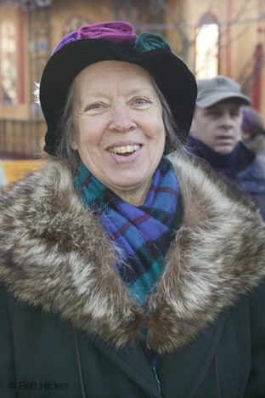
Deborah Healy Age 68 Anchorage, Alaska
Deborah has lived in Anchorage for a long time, but many of her friends and family are now gone. Laura suggested she walk different mall routes/times in order to meet other people in town. If Deborah is having a good conversation with a group while walking, she likes to propose that they meet up later to continue chatting. She used to know the town very well, but it has changed over the years and, until now, Deborah hasn’t needed to keep up with it.
Notes:
Deborah lives in Anchorage, Alaska. Her husband, Walter, passed away last year due to complications after he fell and broke his hip. The couple had two children, Laura (36) and Jeff (32). Jeff moved away to the lower 48 after college to join the Dot Com boom, and has had some moderate success even since the bubble burst. Laura still lives in Anchorage and she has two sons of her own (four and 1 1/2). Since her husband died, Deborah has not had anyone to really take care of, so about 6 months ago, she started to get a bit depressed. This is an especially tough problem in Alaska in the winter, since the sun may only shine for an hour or two a day in December and into January. Deborah decided to try to get some exercise by taking walks in Russian Jack Springs Park down the street from her house. This was fine until the snow arrived in October, making it difficult for her to find the walking paths, and the ice made her nervous that she would succumb to the same fate as her late husband. She started spending more time sitting around at home until her daughter suggested that she walk the other direction down 7th ave and join the mall walkers club at the Northway Mall.

